Slide 1
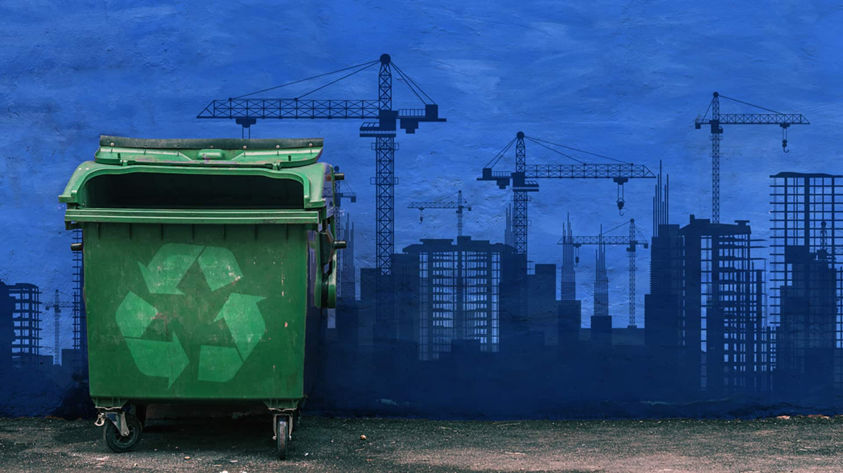
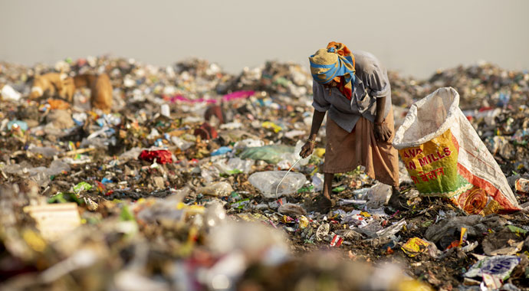
Waste Management: Strategies for a Sustainable Future
Reducing, Reusing, and Recycling for a Cleaner Environment

Slide 2
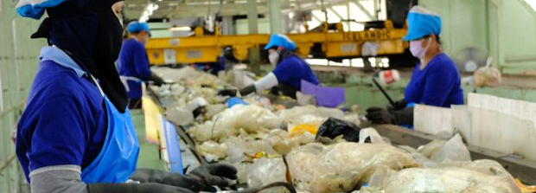
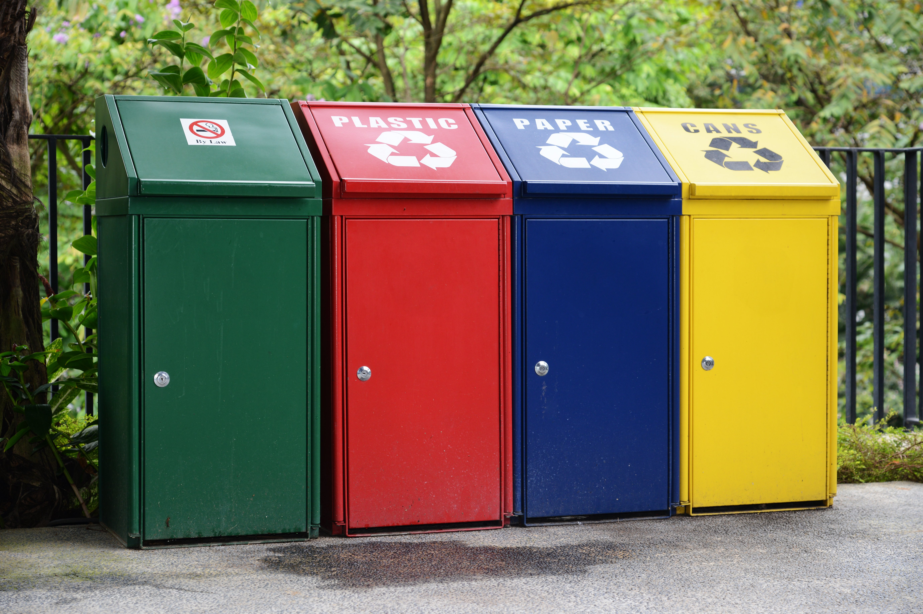
Introduction
Definition of waste management: Waste management refers to the collection, transportation, processing, recycling, and disposal of waste materials in an environmentally responsible manner.
Importance of proper waste management for environmental sustainability: Proper waste management is crucial for protecting the environment, public health, and conserving natural resources.

Slide 3
WHY?

Slide 4
Facts
A Growing Problem:
Globally, only 32% of municipal solid waste (MSW) is recycled.
This means a large portion ends up in landfills or worse, polluting our environment.
An Ocean of Plastic:
An estimated 8 million metric tons of plastic waste enter our oceans every year.
Landfill Laggard:
The global plastic recycling rate sits at a dismal 9%, compared to a much higher 50% recycling rate for construction and demolition waste.

Slide 5
INDIA
India's Growing Garbage Mountains:
India, like many developing countries, faces a significant challenge with waste management. One alarming consequence is the emergence of massive "garbage mountains" on the outskirts of major cities. Here's a breakdown of the situation:
The Problem: Cities like Delhi and Mumbai have become notorious for these towering landfills, some exceeding 60 meters in height – taller than many historical monuments!
Overflowing Landfills: These landfills were originally meant to be temporary solutions, but due to a lack of proper waste management strategies, they've become overflowing and pose serious health and environmental hazards.
Health Impacts: Residents living near these mountains suffer from respiratory problems, skin irritation, and other health issues due to the constant emission of toxic fumes and leachate contamination.

Slide 6
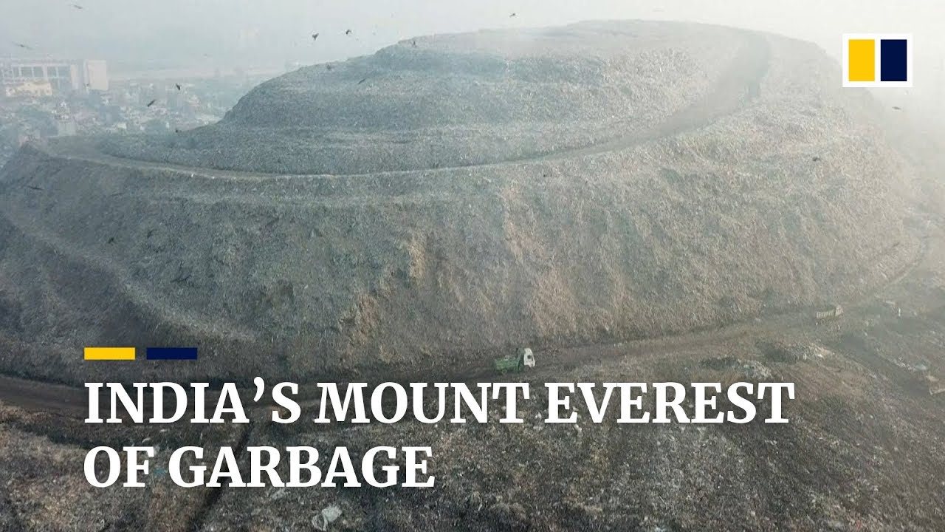

Slide 7
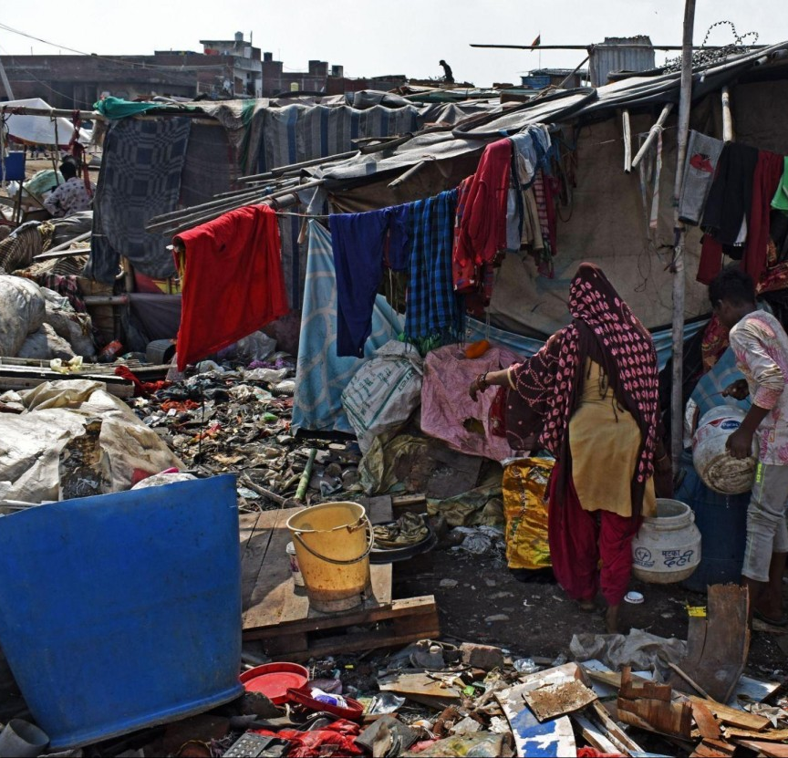
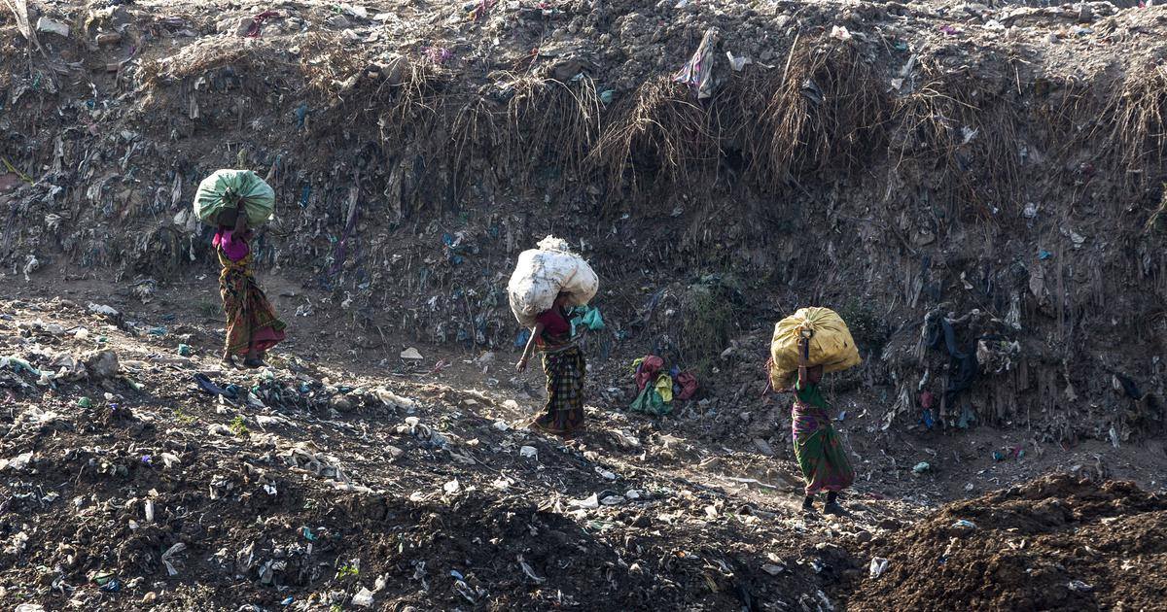

Slide 8
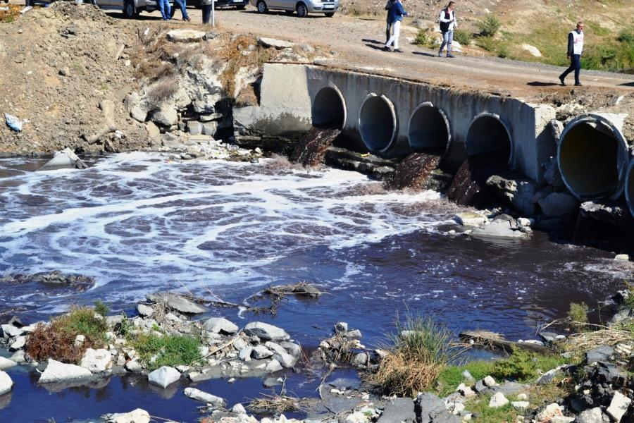
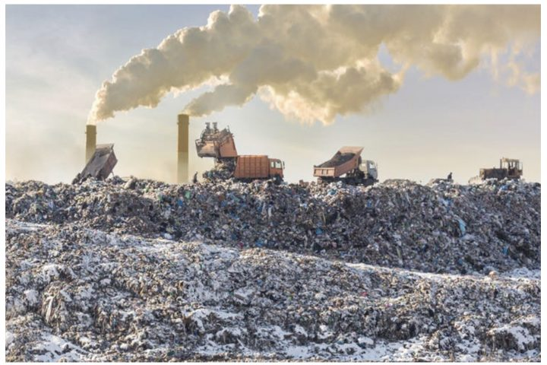
Types of Waste
Classification of waste: Waste can be categorized into three main types: solid waste, liquid waste, and gaseous waste.
Examples of each type of waste:
Solid waste: Household trash, industrial waste, construction debris.
Liquid waste: Wastewater from households, industries, and agricultural activities.
Gaseous waste: Emissions from vehicles, factories, and power plants.

Slide 9
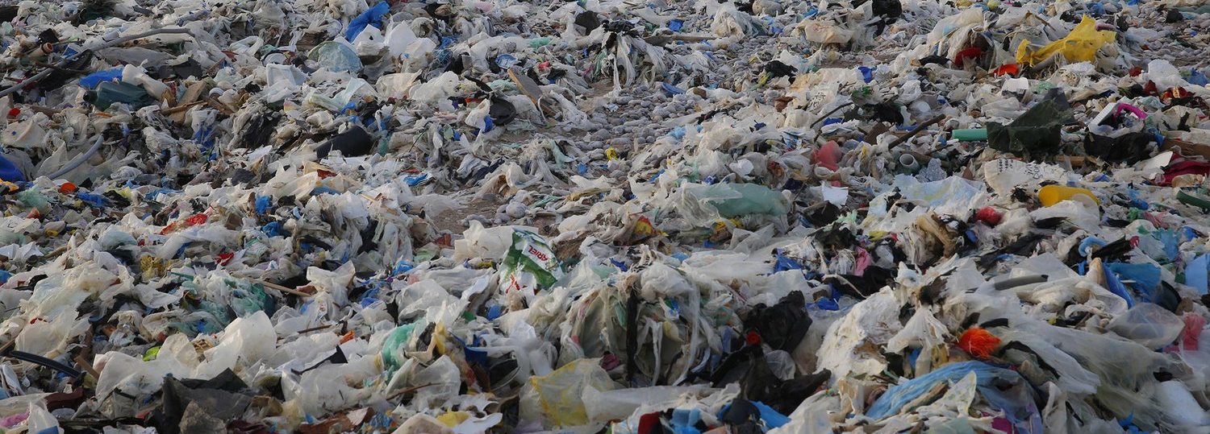
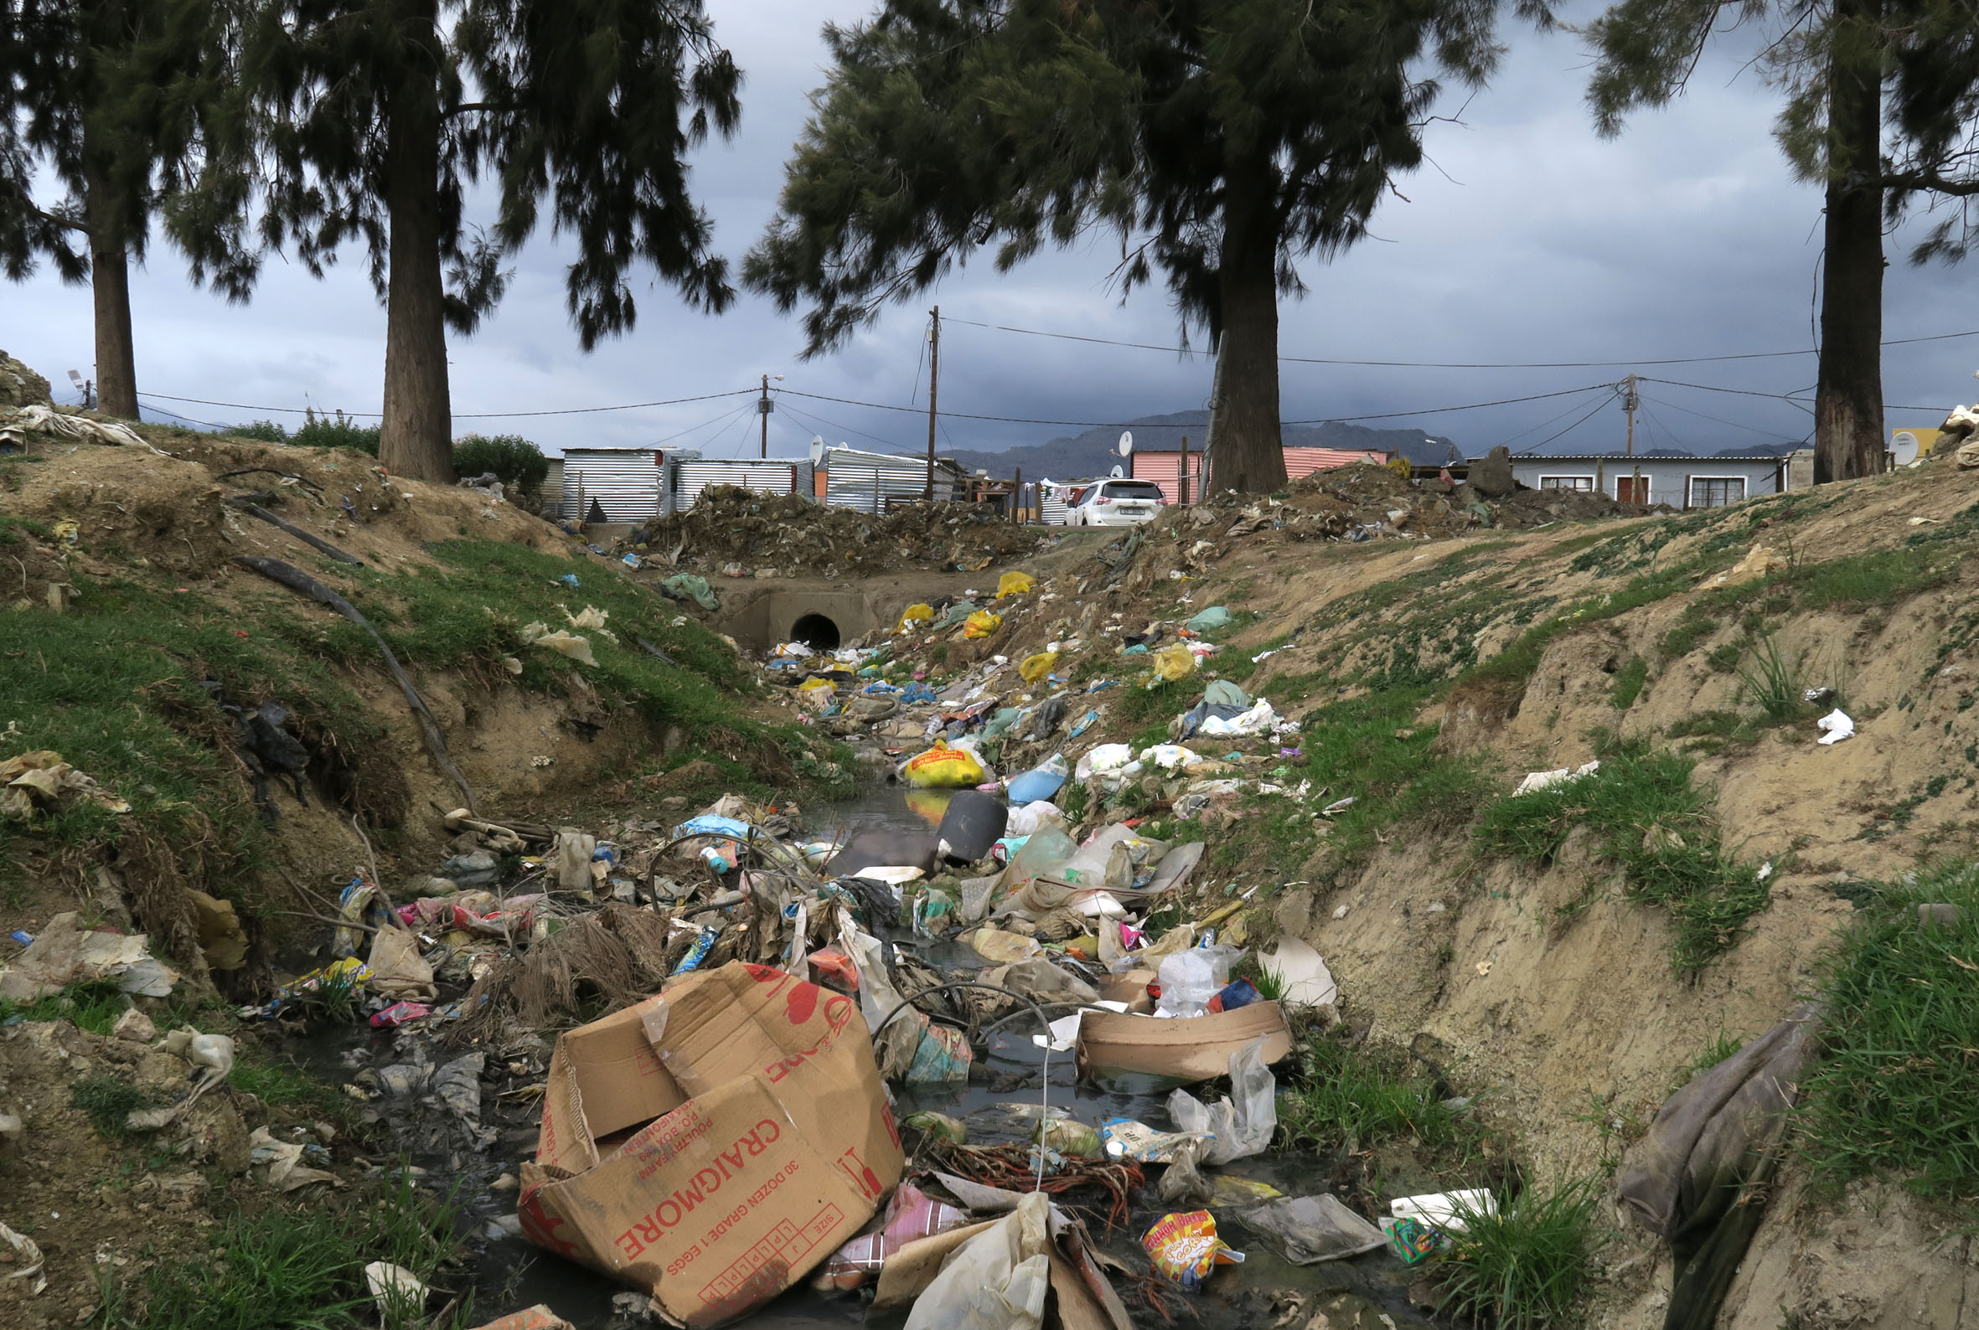
Environmental Impact of Poor Waste Management
Pollution of air, water, and soil: Improper disposal of waste leads to contamination of air, water bodies, and soil, posing serious health risks to humans, animals, and plants.
Harmful effects on wildlife and ecosystems: Wildlife can ingest or become entangled in waste materials, leading to injury or death. Polluted habitats disrupt ecosystems and threaten biodiversity.
Contribution to climate change: Landfills and incineration release greenhouse gases such as methane and carbon dioxide, exacerbating global warming and climate change.

Slide 10
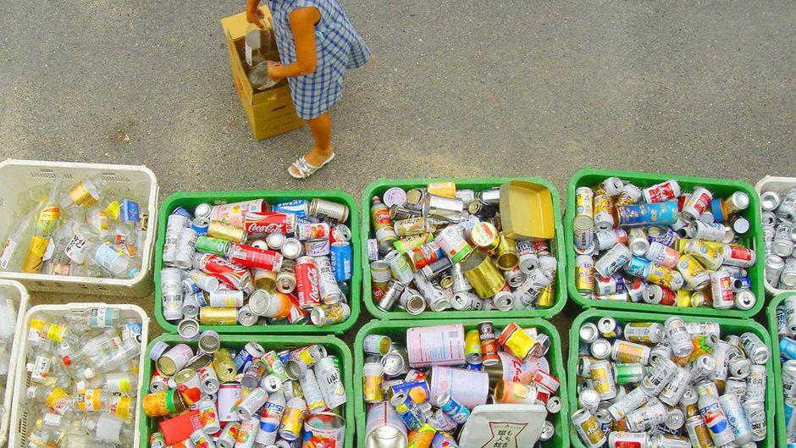
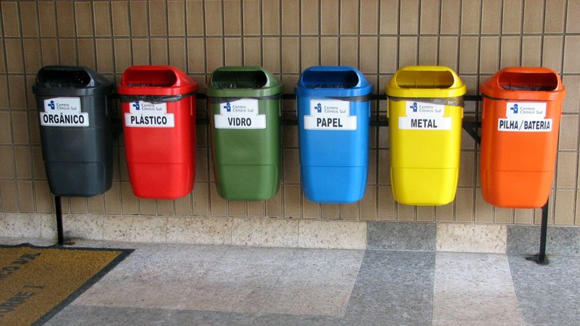
Waste Management Hierarchy
Pyramid diagram illustrating the waste management hierarchy:
Waste prevention: Minimizing waste generation by reducing consumption and adopting sustainable practices.
Waste reduction: Reducing the amount of waste produced through efficient resource use and product design.
Recycling: Repurposing materials to create new products, conserving resources, and reducing the need for raw materials.
Energy recovery: Extracting energy from waste through processes like incineration, anaerobic digestion, or landfill gas recovery

Slide 11
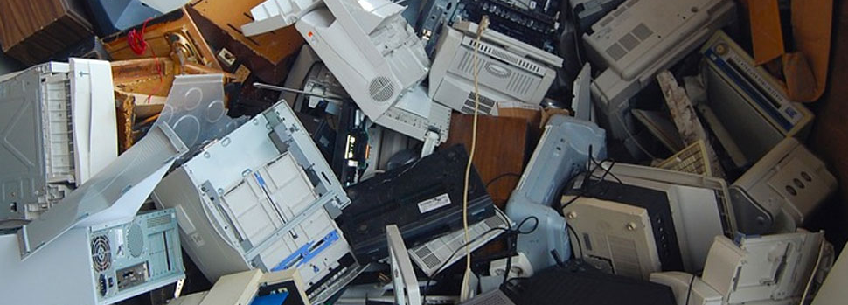
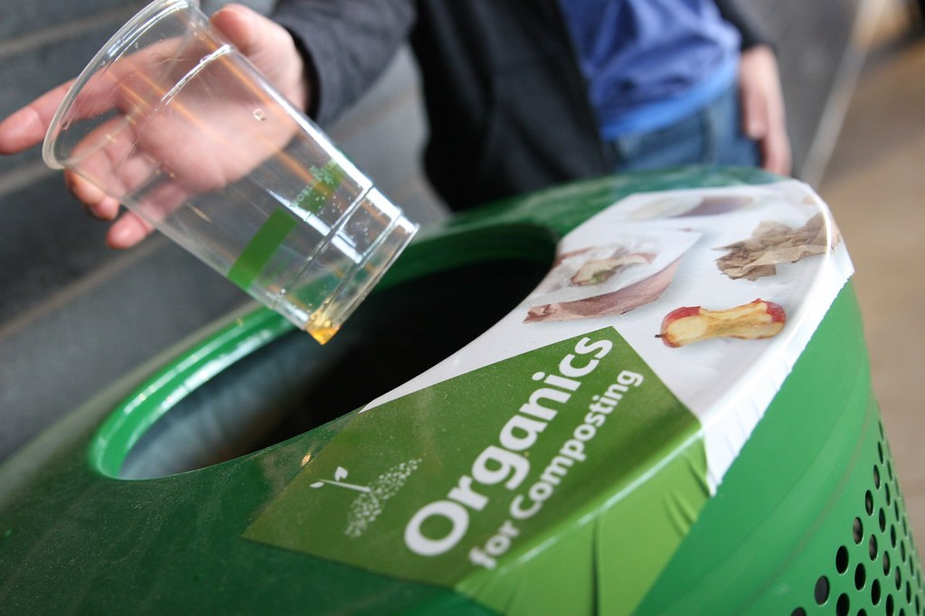
Waste Prevention and Reduction
Strategies to minimize waste generation:
Product redesign: Designing products with longevity, recyclability, and minimal packaging.
Packaging reduction: Using eco-friendly packaging materials and adopting reusable or refillable packaging.
Education and awareness: Promoting waste reduction practices through public education campaigns and consumer awareness programs.

Slide 12
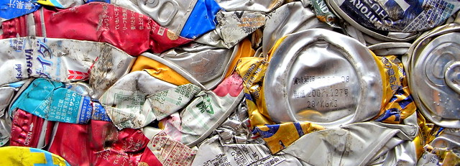
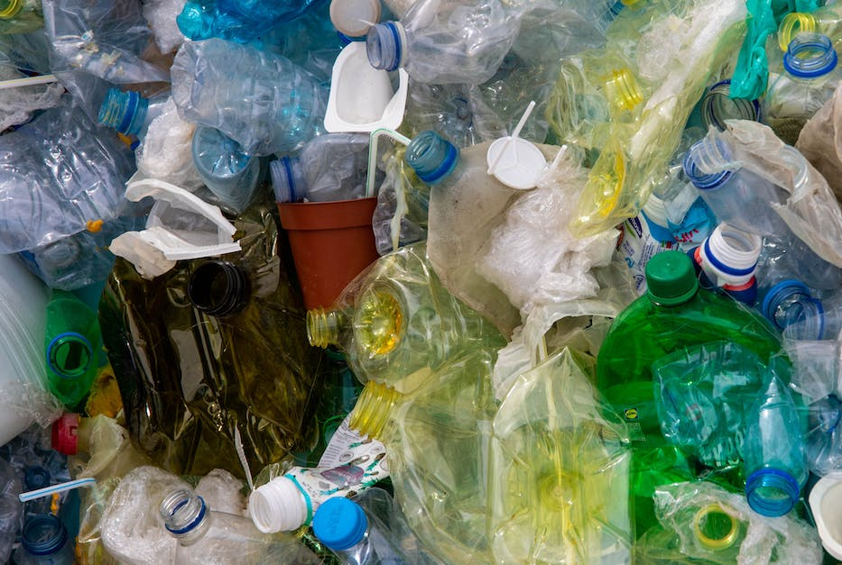
Recycling
Importance of recycling: Recycling conserves natural resources, reduces energy consumption, and minimizes the environmental impact of waste disposal.
Commonly recycled materials:
Paper: Newspapers, cardboard, office paper.
Plastic: Bottles, containers, packaging materials.
Glass: Bottles, jars, containers.
Metal: Aluminum cans, steel cans, scrap metal.

Slide 13
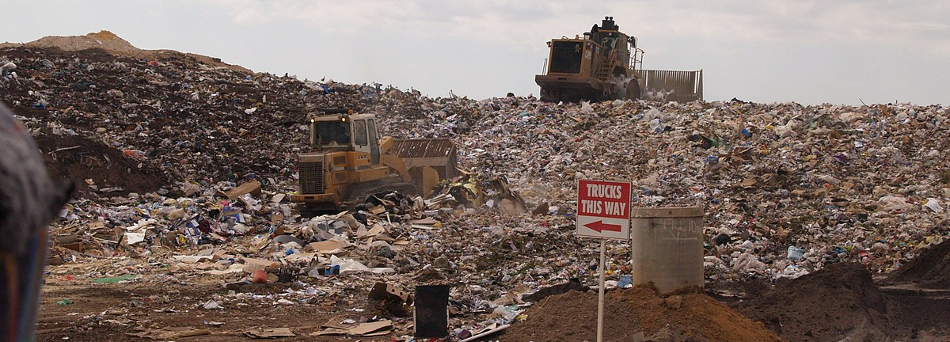
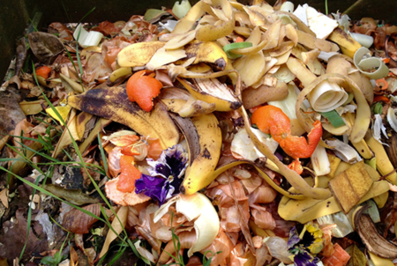
Composting
Explanation of composting process: Composting is the natural decomposition of organic waste materials such as food scraps, yard trimmings, and paper into nutrient-rich compost through microbial activity.
Benefits of composting:
Organic waste diversion: Composting diverts organic waste from landfills, reducing methane emissions and soil contamination.
Greenhouse gas reduction: Composting sequesters carbon in the soil, mitigating climate change by reducing atmospheric carbon dioxide levels.

Slide 14
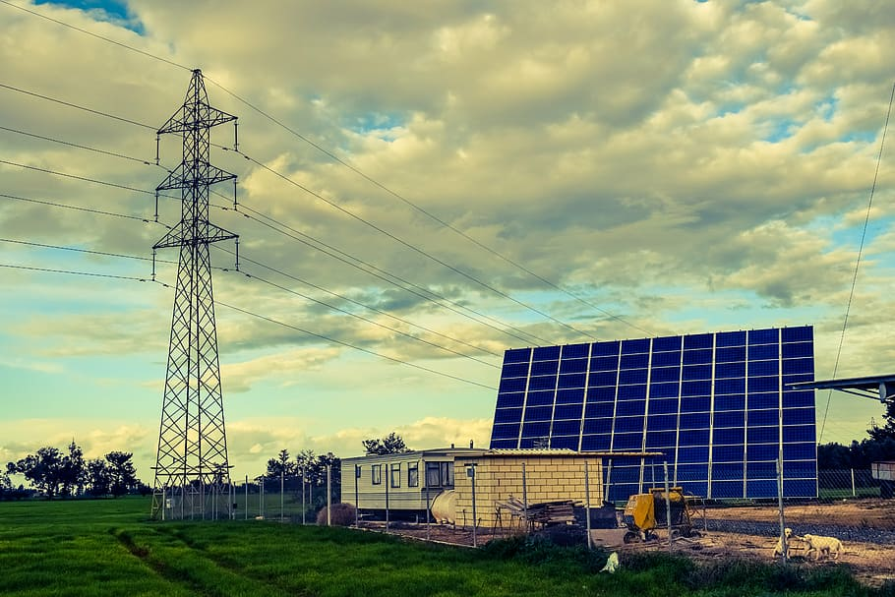
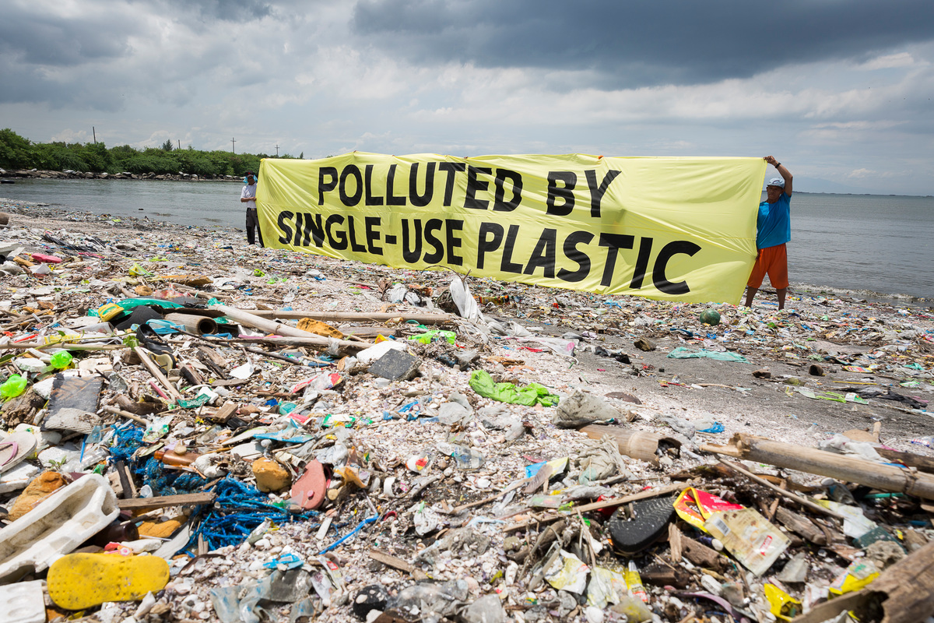
Energy Recovery
Overview of waste-to-energy technologies: Waste-to-energy technologies convert waste materials into heat, electricity, or fuel through processes such as incineration, anaerobic digestion, and landfill gas recovery.
Incineration: Burning solid waste to generate heat or electricity, while reducing the volume of waste and minimizing environmental pollution through advanced emissions control technologies.
Anaerobic digestion: Decomposing organic waste in an oxygen-free environment to produce biogas (methane) and nutrient-rich digestate, which can be used for energy production or soil amendment.

Slide 15


Conclusion
Recap of key points: Proper waste management is essential for protecting the environment, public health, and conserving natural resources. By adopting waste prevention, recycling, composting, and energy recovery strategies, individuals, communities, and businesses can contribute to a cleaner, healthier, and more sustainable future.
Call to action: Encouragement for individuals and organizations to take action by reducing waste generation, recycling materials, composting organic waste, and advocating for policies and practices that promote sustainable waste management.

